Slide 1
One hidden layer
Neural Network
Derivatives of
activation functions

Slide 2
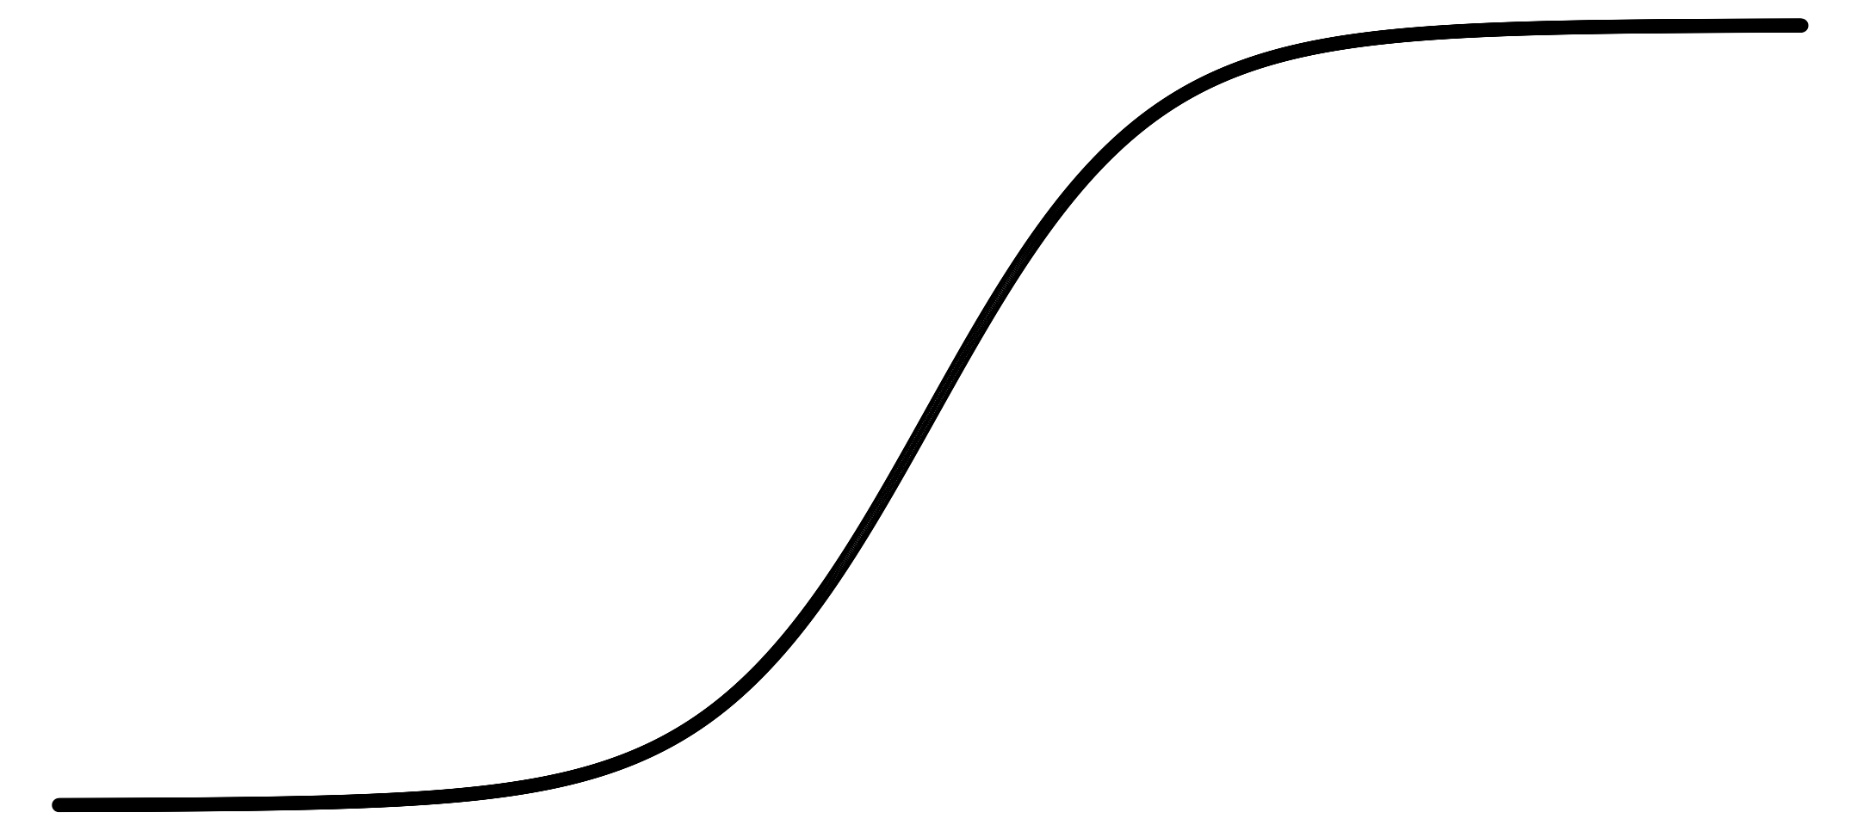
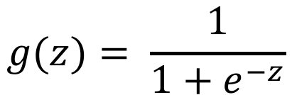
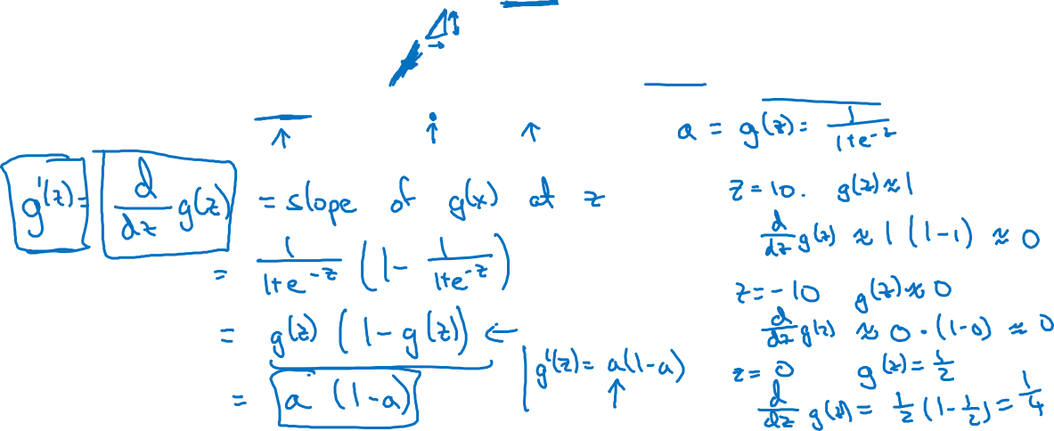
Sigmoid activation function
a
$$g(z)= \frac{1}{1+e^{−z}}$$
z

Slide 3

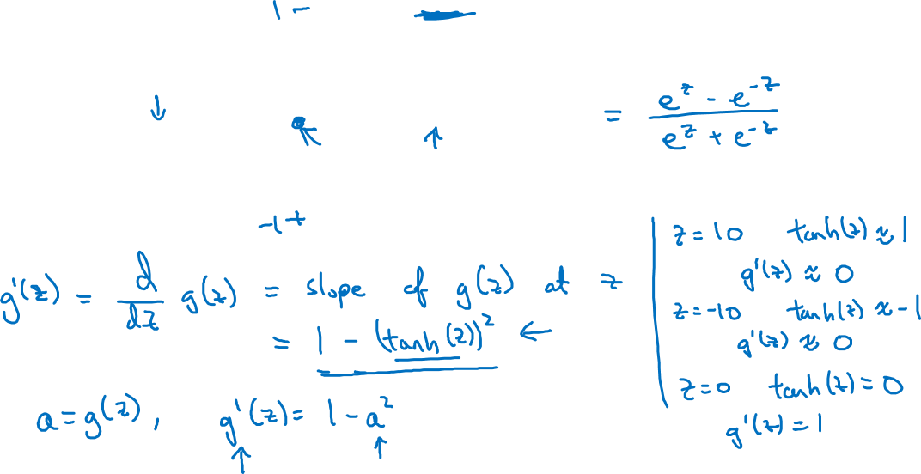
Tanh activation function
a
$$g(z)=tanh(z){ }$$
z

Slide 4
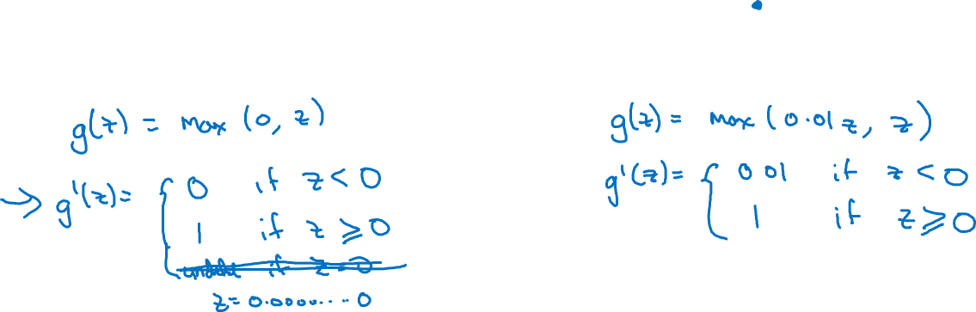
ReLU and Leaky ReLU
a
a
z
z
ReLU
Leaky ReLU

